Slide 1
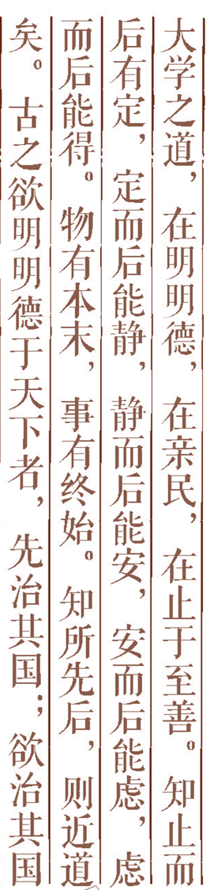


Artificial Intelligence Chapter 20 Leaning and Acting with Bays Nets

Slide 2



20.1 Leaning Bayes Nets
20.2 probabilistic inference and action
20.3 Additional reading and discussion
Outline

Slide 3
20.1 Leaning Bayes Nets
20.1.1 Known Network Structure
--No Missing Data
--Missing Data
20.1.2 Learning Network Structure
--The Scoring Metric
--Searching Network Space

Slide 4
No Missing Data
L
G M B L Number of instance
True T T T 54
T T T F 1
T F T T 7
T F T F 27
F T T T 3
F F T F 2
F F F T 4
F F F F 2
B
G
M

Slide 5
Missing Data
L
G M B L Number of instance
True T T T 54
T T T F 1
* * T T 7
T F T F 27
F T * T 3
F F T F 2
F F F T 4
F F F F 2
B
G
M

Slide 6
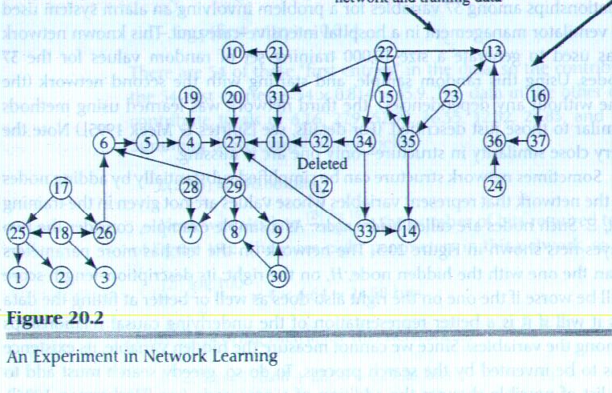
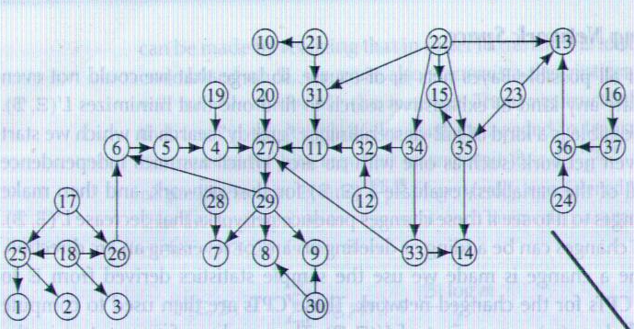
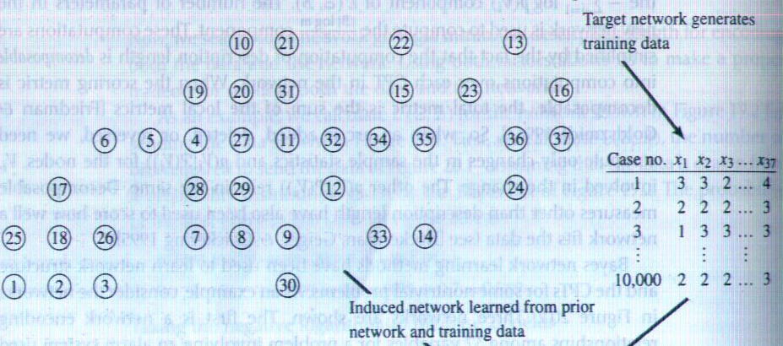
20.1.2 Learning NetworkStructure

Slide 7
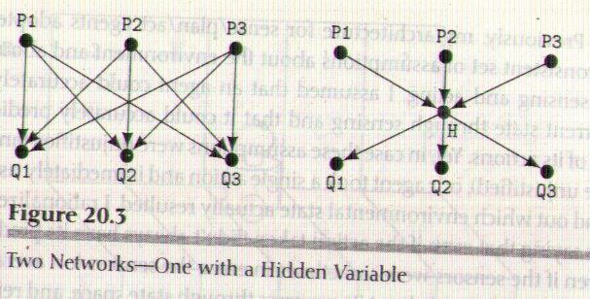

Slide 8
20.2.1 the general setting
There are many applications of probabilistic inference.A prominent one is in expert system for making best guesses based on general knowledge applied to specific data.

Slide 9
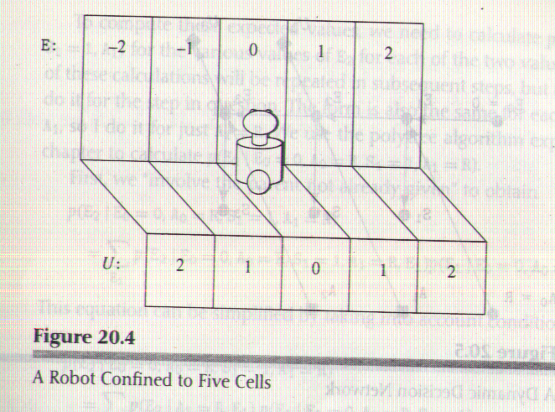
20.2.2 an extended example

Slide 10
20.2.3 generalizing the example
板书

Slide 11
Additional reading and discussion

